Slide 1
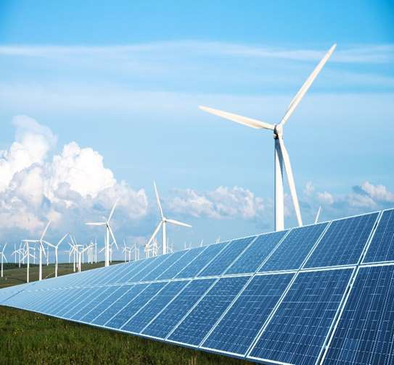

Ever y t h i ng Energy
Carbon Offset
Service Description
W o r l d - K i n e c t . c o m
Copyright © 2020 World Fuel Services Corporation. Proprietary & Confidential. All Rights Reserved.

Slide 2







We solve energy challenges
200+
COUNTRIES & TERRITORIES OPERATIONAL
From liquid fuel products to electricity, natural gas, and clean energy, our team of certified energy professionals ensure the energy challenges of our customers are solved safely and reliably.
77,000+
CUSTOMERS
$36.8B
2019 REVENUE
World Kinect Energy Services Focuses On:
200TWh
ENERGY
PORTFOLIO
5,000+
DEDICATED ENERGY PROFESSIONALS
Delivering the energy you need.
Protecting your budget.
50+
ENERGY PRODUCTS
Reducing your carbon footprint.
Copyright © 2020 World Fuel Services Corporation. Proprietary & Confidential. All Rights Reserved.

Slide 3




We help our customers reduce their carbon footprint.
Our track record, at a glance*:
30 MWh
Onsite Solar
under development
1.9 TWh
of physical renewable power managed
500 GWh
of renewable power tendered in the UK
249 MWh*
VPPAs Placed
* three-year total
250+
renewable energy
power plants in our REC Portfolio
1.4 TWh
Renewable PPA Management
315.8 GWh
of renewable power managed in Australia
22.1 M gallons
of SAF delivered to aviation customers since 2015
25+ TWh
RECs Sourced
Copyright © 2020 World Fuel Services Corporation. Proprietary & Confidential. All Rights Reserved.
*All fgures are as of July, 2020

Slide 4

Carbon Offsets +
World Kinect Energy Services
The global World Kinect Energy Services (WKES) sustainability team offers a full range of services to help businesses manage their impacts on the environment; including the use of carbon offsets to help clients better manage their carbon footprint, meet carbon reduction targets and become carbon neutral.
We have been active in the voluntary carbon market since early 2005 and have a dedicated team of experts focusing on providing our clients with outstanding support and guidance in this complex market.
Copyright © 2020 World Fuel Services Corporation. Proprietary & Confidential. All Rights Reserved.

Slide 5
What is a Carbon Offset?
In simple terms, a Carbon Offset represents a reduction in greenhouse gas emissions that can be used to compensate for emissions made somewhere else.
Purchasing Carbon Offsets allows companies to lower their carbon footprint while supporting projects worldwide that reduce carbon emissions, like afforestation.
Carbon Offset projects typically contribute to the improvement of life for people across the globe through better access to energy, improved health, education and jobs. In many cases, Carbon Offset projects protect thousands of hectares of ecologically significant habitat.
Copyright © 2020 World Fuel Services Corporation. Proprietary & Confidential. All Rights Reserved.

Slide 6




Our Carbon Offset Offering
Carbon offsets can be used to compensate for business emissions. The process involves calculating the total amount of carbon emissions associated with business operations in tonnes of CO2 equivalents (CO2e), namely the carbon footprint. Then an equivalent amount of carbon offset credits from a recognised emission reduction project can be purchased to offset the business emissions.
WKES provides end-to-end, full-service management of project sourcing, trading, delivery, and retirement of certificates with communication materials to fit our customers’ needs. WKES provides tailor-made solutions to all companies to fit their sourcing strategy and environmental targets across..
Three main
product packages :
Carbon offsets as a
standalone product
Carbon embedded
fuel product
Consulting &
strategy workshops
Copyright © 2020 World Fuel Services Corporation. Proprietary & Confidential. All Rights Reserved.

Slide 7

Carbon offsets as a standalone product
We short-list projects that fully comply with industry requirements, which means they have been independently verified against the approved international standards such as the Verified Carbon Standard (VCS), Gold Standard or the United Nations’ Clean Development Mechanism (CDM).
These standards provide a methodology framework, independent verification process and registry to ensure emissions reductions are real, additional, permanent and unique. We have direct access to carbon offset projects across the globe and a customized sourcing solution of carbon offsets fitting all specifications across:
The WKES carbon offset offering acknowledges the intricate details of the global carbon offset market while also encompassing the flexibility and specifications needed for each company. Our offering includes multiple purchasing options to meet a customer’s requirements, e.g different price levels and branding value of projects.
WKES will provide a range of projects based on the customer’s specification and an indicative or a firm price depending on the time to decision-making.
- Project technologies
(e.g. wind, solar, cook stoves, landfill gas and forestry)
- Certification schemes
(Gold Standard, VCS, and CCBA)
- Vintage of carbon offsets
- Project size
- Geographic locations
Copyright © 2020 World Fuel Services Corporation. Proprietary & Confidential. All Rights Reserved.

Slide 8

Carbon offsets as a standalone product cont’d.
We believe in rigorous assessment criteria and selection processes that seek to ensure the integrity of the emissions reductions and the positive impact on the communities where the projects operate. Offset projects should contribute to improving the lives of people in the local communities through better access to energy, improved health, education and jobs. Many of them also protect thousands of hectares of globally significant habitat.
Our carbon expert team carefully assesses each project’s robustness and ability to deliver socio-economic and environmental benefits based on their contribution to the UN Sustainable Development Goals. WKES delivers corresponding documentation that allows customers to report that they are carbon neutral for the portion of their carbon emission that they have offset.
We provide market access to companies regardless of volume that needs to be purchased. We can offset the entire carbon footprint of a company or just part of the operational activity. Flexibility is a core part of our carbon offset offering.
Copyright © 2020 World Fuel Services Corporation. Proprietary & Confidential. All Rights Reserved.

Slide 9


Carbon embedded fuel product
WKES advices on all aspects of selecting a carbon offset project and can guarantee high quality carbon offsets. The carbon embedded fuel service includes offsetting consumption from:
We provide companies the opportunity to purchase carbon offsets bundled together with their fuel purchase. This product package involves a complete solution for our customer’s carbon exposure, offering globally acknowledged emission factors and the calculation of fuel associated carbon emissions, market advice, cost per liter or gallon of fuel and ultimately market access.
This allows our clients to focus on their core business while our carbon team takes care of the entire sourcing strategy. It is also possible to integrate the cost of carbon offsets in the fuel invoice.
Gas oil
Marine gas oil
LPG
Propane
Diesel
Jet fuel
Petrol
Natural gas
Copyright © 2020 World Fuel Services Corporation. Proprietary & Confidential. All Rights Reserved.

Slide 10
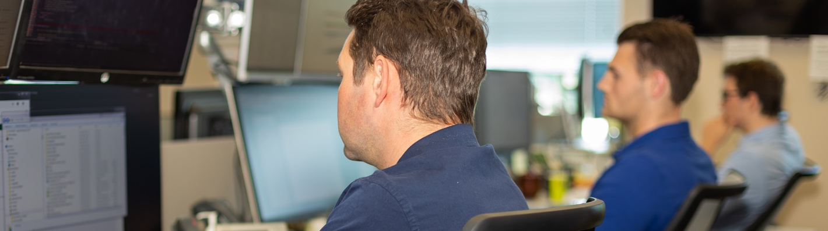
Consultancy & strategy workshops
We provide our clients with carbon offset market intelligence through consultancy or workshops. We can provide support in developing a sourcing strategy which will allow our clients to optimize the additional value of carbon offsetting.
The WKES carbon team has a proven track record in providing custom consultancies and analyses and the team has over 15 years of experience from international carbon markets providing credibility and accountability to our offering.
A core part of our tailored delivery includes a risk assessment of project specific risks and the associated branding risks as these can differ significantly between the different projects and locations.
To be able to deliver services with high quality, the WKES team is continuously focusing on monitoring markets, existing and upcoming regulations, developments in standards and guidelines and participating in key expert forums internationally to develop and share our expertise.
Copyright © 2020 World Fuel Services Corporation. Proprietary & Confidential. All Rights Reserved.

Slide 11

Why choose WKES
as your carbon
offset partner?
Our value proposition is simple. We assist our clients on the whole journey to become carbon neutral through our expertise, up-to-date market knowledge and our vast network of project owners globally. In WKES we have no ownership in any carbon offset project assets something that enables us to advice and guide our customers to the best possible sourcing solutions for their business.
Please contact us to learn more about how we can assist your company’s carbon neutral journey:
sustainability@world-kinect.com
Copyright © 2020 World Fuel Services Corporation. Proprietary & Confidential. All Rights Reserved.

Slide 12
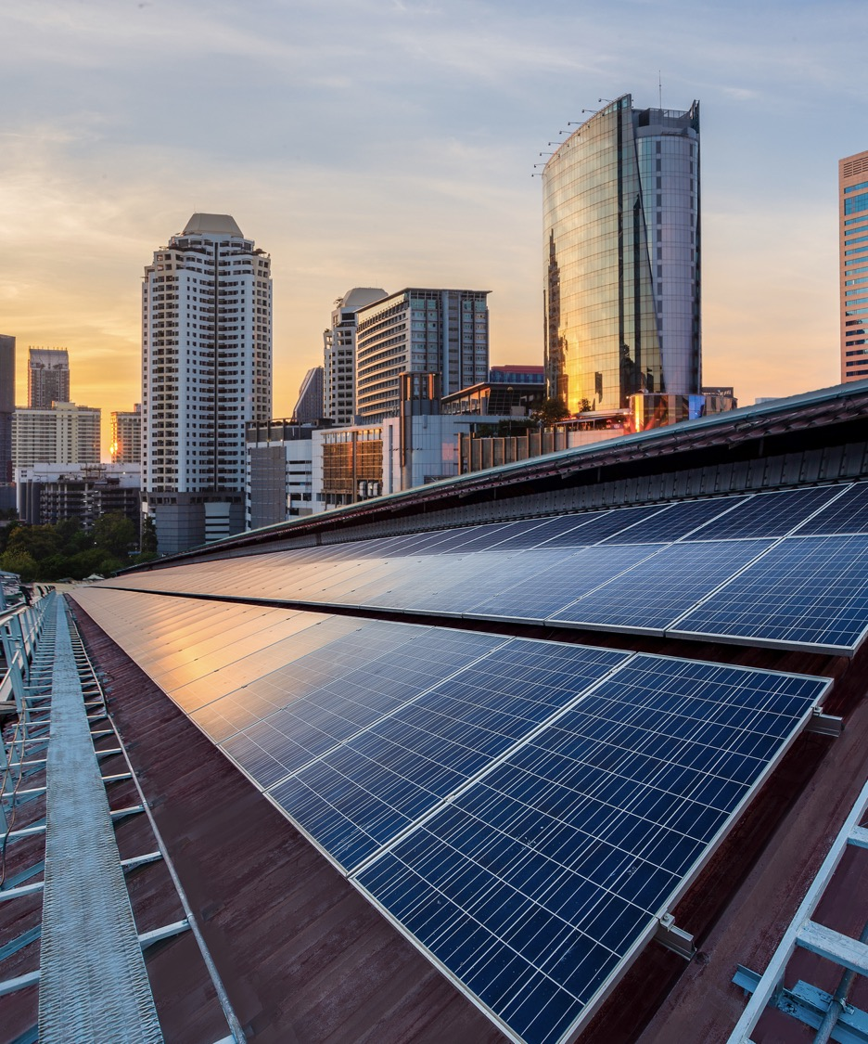

We are committed to protecting our environment while reducing the
impact of our global operations.
Our World Kinect energy management business has been carbon neutral in Europe since 2013, and globally since 2016.
In 2019, we became a signatory to the United Nations (‘‘UN’’) Global Compact, the world’s largest corporate responsibility initiative covering human rights, labor practices, the environment and anti-corruption.
Since 2019, we have taken significant steps to making our UK fuels business carbon neutral, thanks to Gold Standard carbon offsets supporting forestry projects.
In September 2019, we joined the "Getting to Zero Coalition" a partnership between the Global Maritime Forum, the Friends of Ocean Action, and the World Economic Forum focused on developing fuels, energy solutions and tech for zero emission deep-sea vessels by 2030.
We are also a member of the Coalition of Sustainable Aviation Fuel (SAF) supporting the business aviation industry's goal to reduce carbon emissions 50% by 2050. Since 2015, we have delivered nearly 22.1 M gallons of SAF to our aviation customers.
Later this year, we will provide our first annual ‘‘Communication on Progress’’ report, setting out our actions to implement the UN Global Compact principles and our progress in these key areas.
Copyright © 2020 World Fuel Services Corporation. Proprietary & Confidential. All Rights Reserved.

Slide 13
Ever y t h i ng Energy
Thank you
W o r l d - K i n e c t . c o m
Copyright © 2020 World Fuel Services Corporation. Proprietary & Confidential. All Rights Reserved.

